Slide 1
Airline Topic Labelling
By: Gabriel
Notes:
To change the image on this slide, select the picture and delete it. Then click the Pictures icon in the placeholder to insert your own image.

Slide 2



Scope
Problem Statement
Exploratory Data Analysis
Topic Modelling
Classification
Conclusion

Slide 3




Problem Statement
Airlines deal with large volumes of unstructured text every day. How can airline leverage on topic modelling to automatically segregate text reviews into respective topic (department) so that respective departments can execute next call to action in a timely manner?

Slide 4
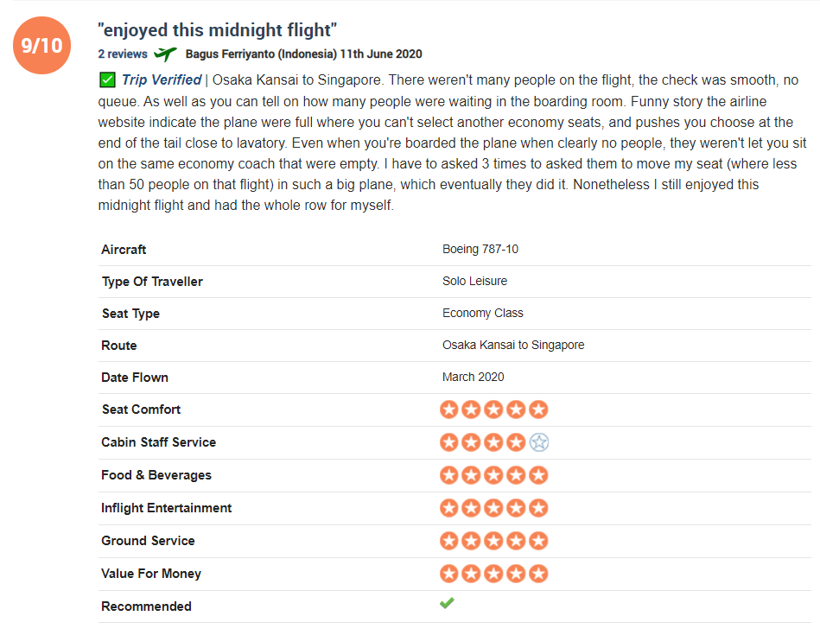

Problem Statement
Departments
Departments

Slide 5
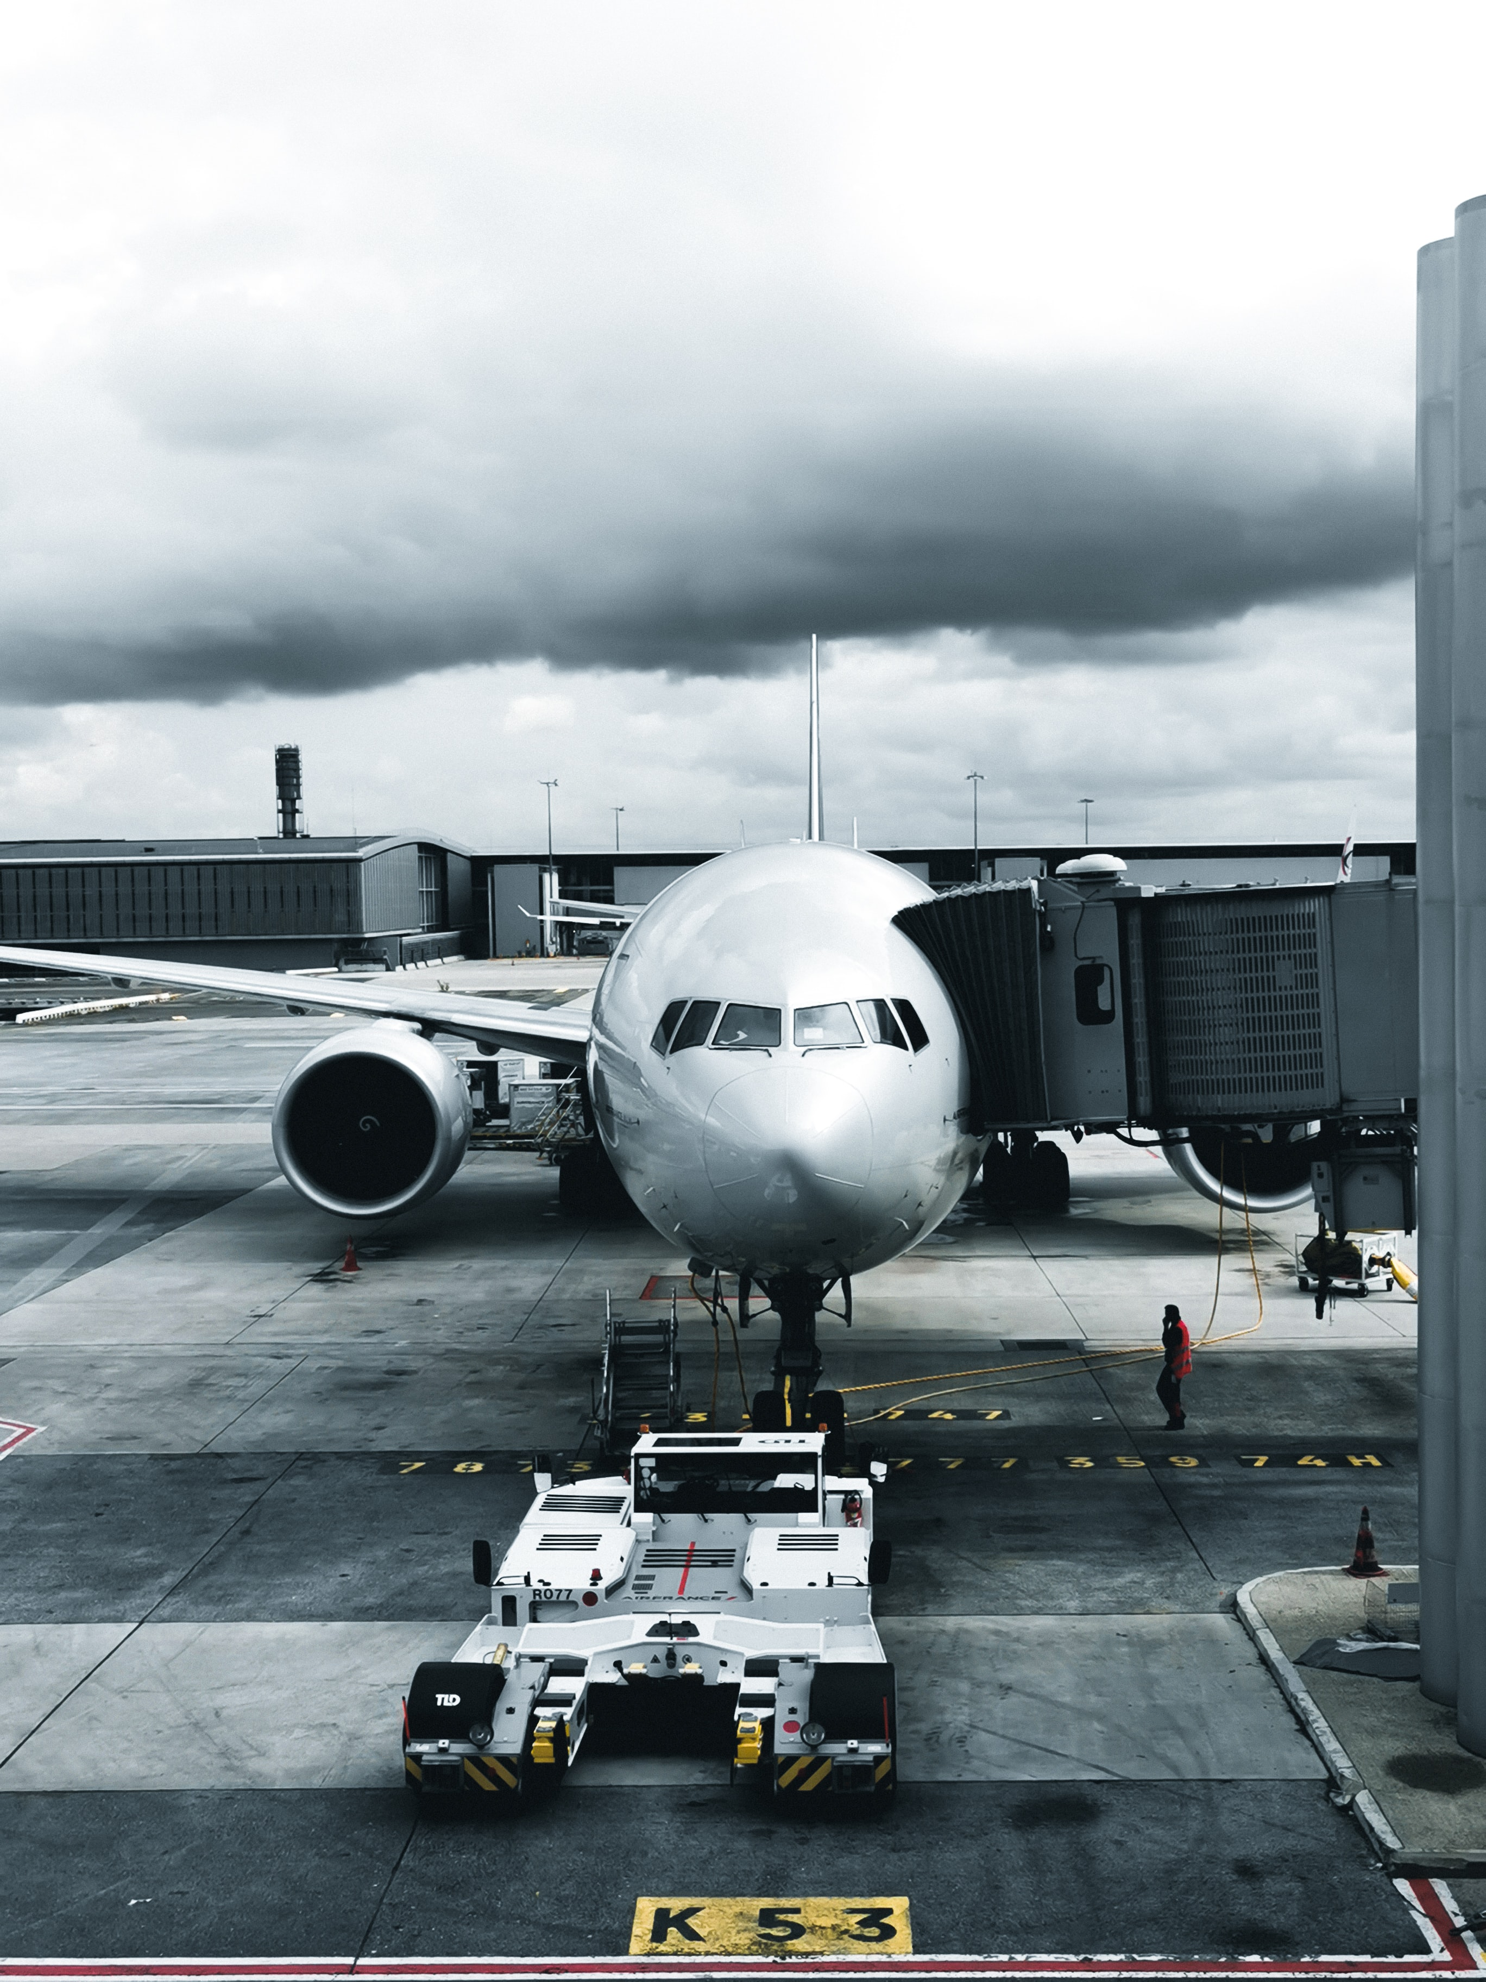
Exploratory Data Analysis
Notes:
To change the image on this slide, select the picture and delete it. Then click the Pictures icon in the placeholder to insert your own image.

Slide 6
Mean Overall Rating
The overall ratings is a sentiment of how the user perceived the overall quality in terms of service and attitude of the respective airlines.
We observed that there’s a drastic drop in overall ratings since 2011
More reviews that needs to be addressed

Slide 7
Mean Overall Rating
Singapore airline is ranked one of the top airlines in the world.
However according to the charts, it shows that the mean overall rating has dropped from a high score of 8 in 2013 to a score of less than 6 in 2020.

Slide 8
Mean Overall Rating
ANA All Nippon Airways showed otherwise
ANA have been actively bringing new technological innovations to improve efficiency

Slide 9
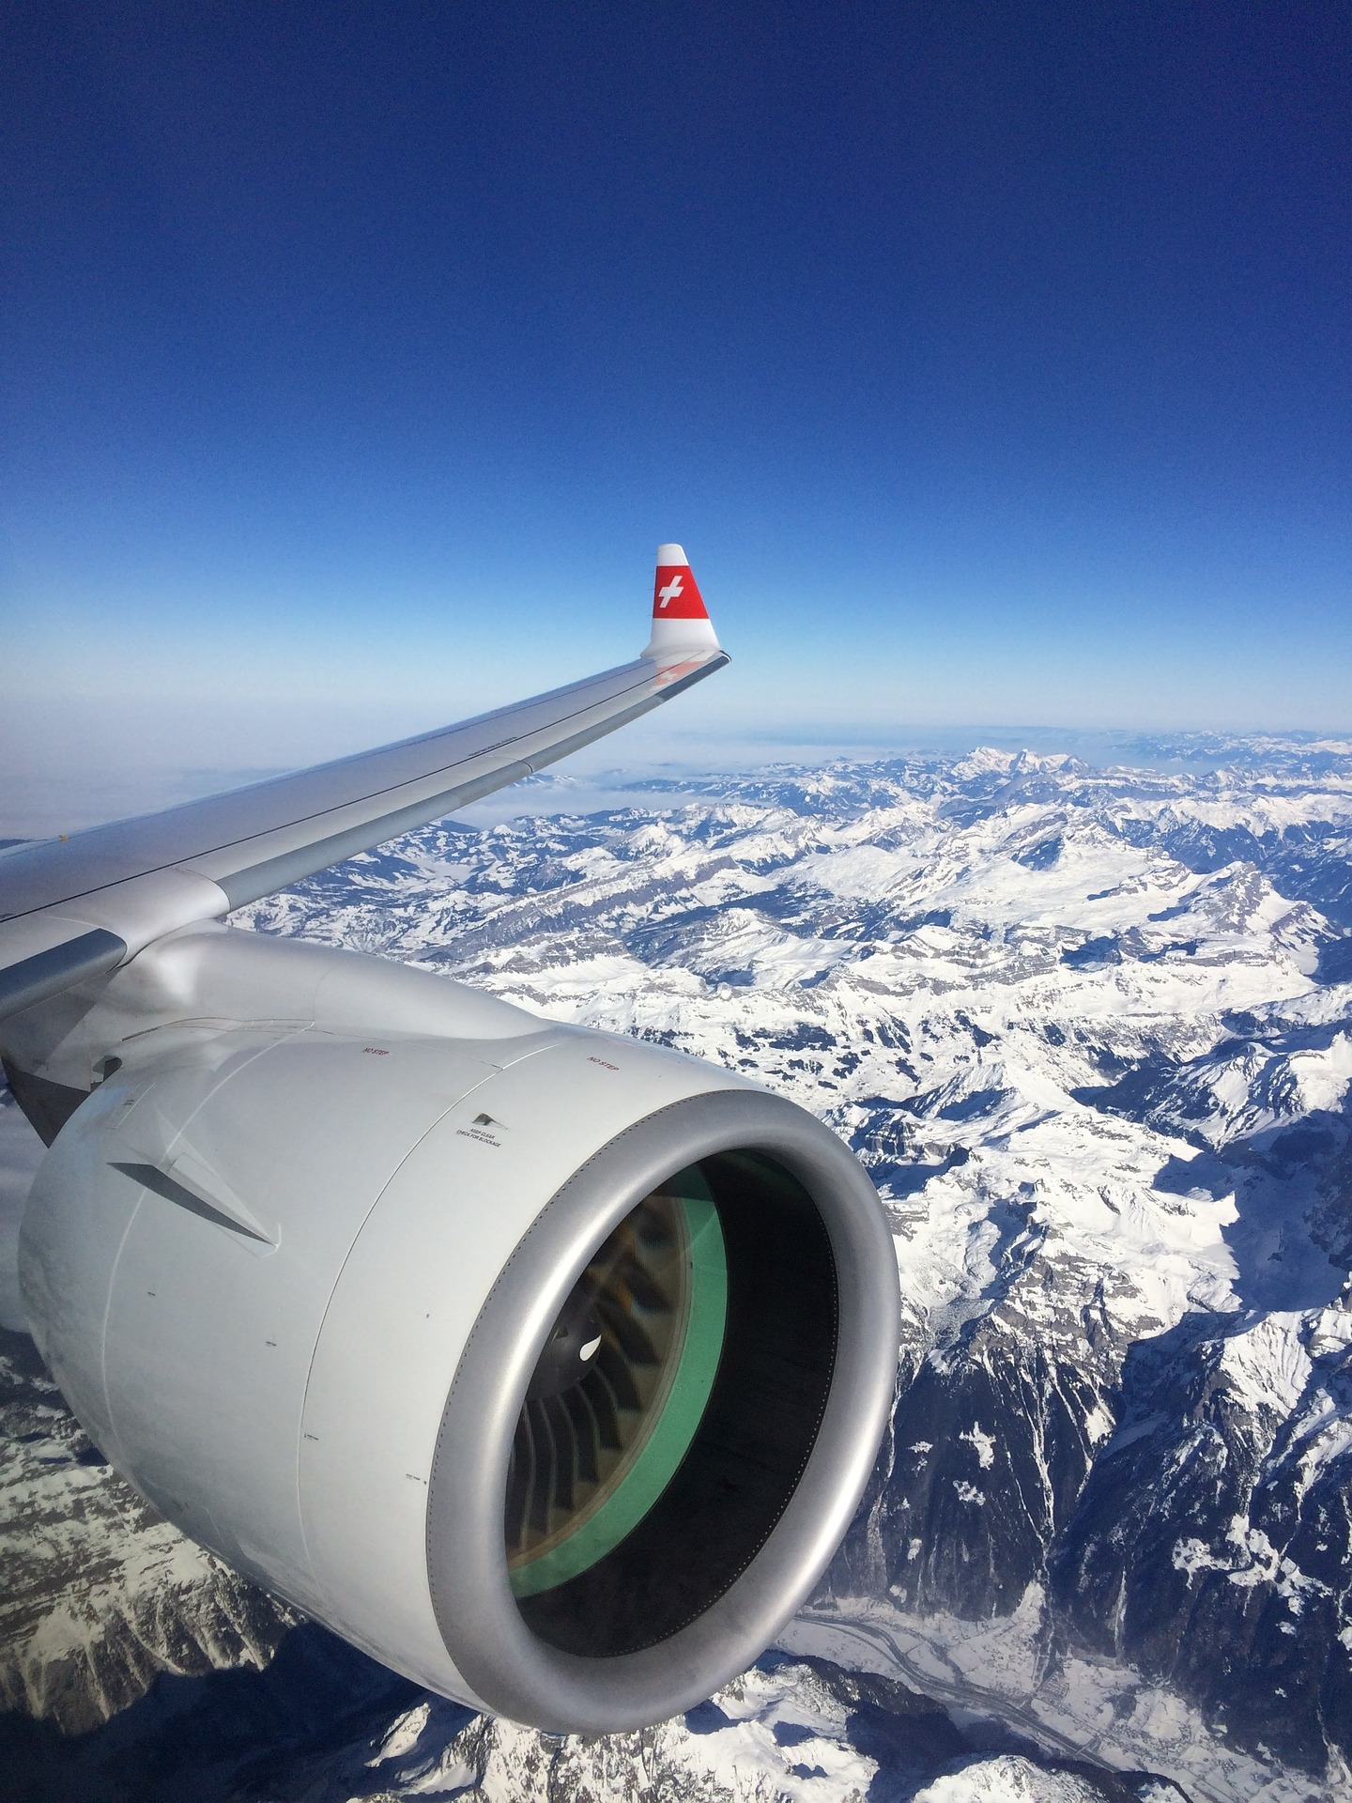
Topic Modelling
Notes:
To change the image on this slide, select the picture and delete it. Then click the Pictures icon in the placeholder to insert your own image.

Slide 10


Process
 | Doc-1 | Doc-2 | Doc-3
Topic 1
Topic 2
Bag of Words
Topic Modelling
(LDA)
Notes:
Segregate into Relatable topics

Slide 11

Scoring Method
Food
Semantically Different
Luggage
Unsupervised
Topic Coherence
Semantic similarity between high scoring words
C_V typically 0 < x < 1
Semantically Similar
Baggage
Class | C_V
TF-IDF | 0.537
Count Vectorizer | 0.485

Slide 12

Word Labels
In-Flight Experience
Meals
Seats
meal was really poor, and they did not offer a choice. cabin staff service also very poor.
Passenger Handling
Check-in
Boarding process
Flight Operation
Delays
Cancellation

Slide 13
Word Labels
Reviews | Topic
great prices and a great service. every airline sometimes has problems with delays or luggage (just read the reviews on this site to find that out). maxjet do a fantastic job and given the price you pay it would be crazy to complain! the food is fine the seats comfortable entertainment fine (turn your dinner tray sideways and it all fits by the way!) and service fantastic. flying from london stansted is much easier than heathrow or gatwick. | In-flight experience
I recently flew from athens to milan. one extra bag cost 325 euro. i could have purchased two tickets providing for two adults with bags for each less expensive. the counter agents were disinterested and responded to each other in greek which i do not understand. this practice is unreasonable and unacceptable. | Passenger Handling
verona-timisoara-chisinau. the flight from verona departed almost 5 hours late resulting in 4.5 hours late arrival at the final destination. the company didn't provide sufficient information as to the causes of delay. voucher provided for food and drinks doesn't get you much in verona airport. | Flights Operation

Slide 14
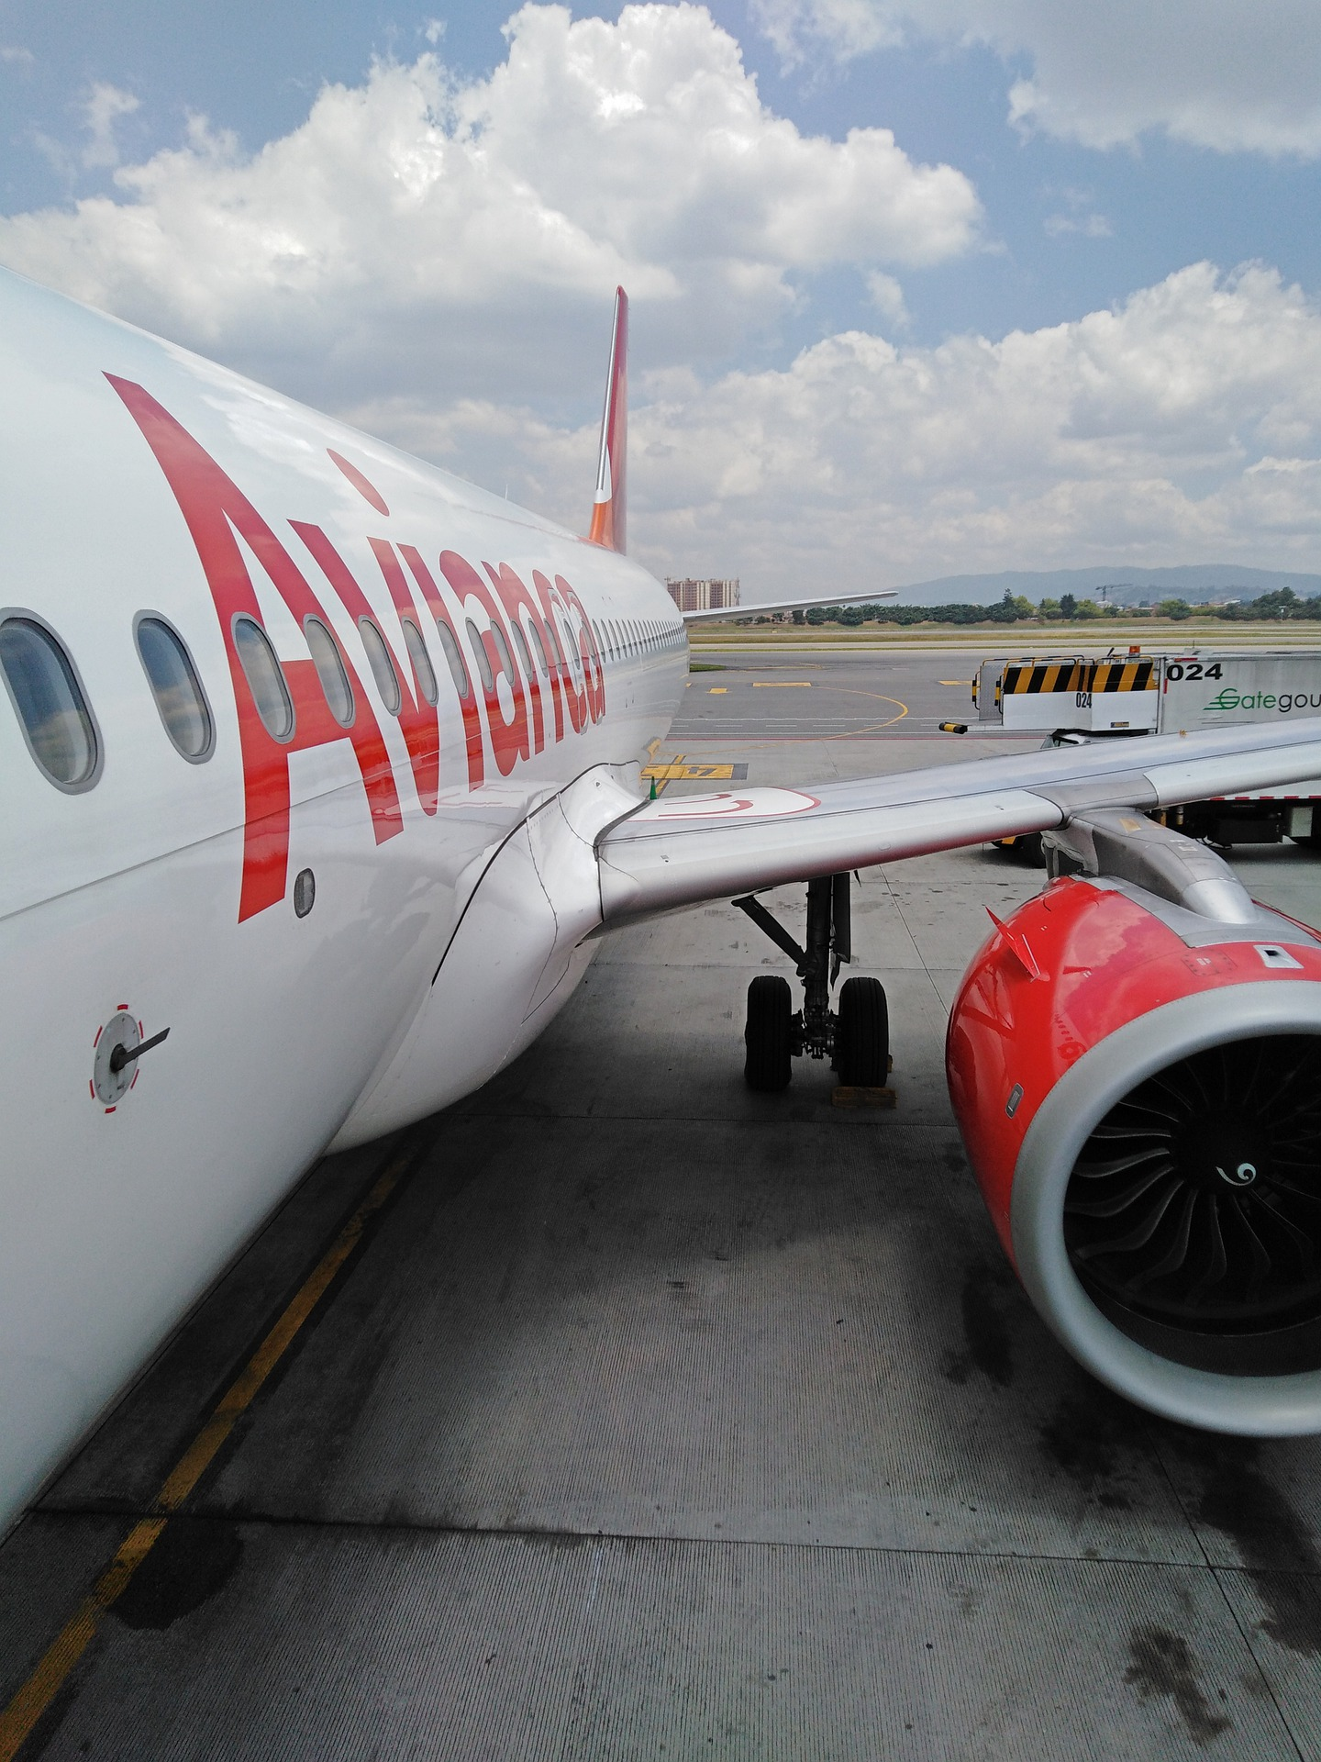
Text Classification
Notes:
To change the image on this slide, select the picture and delete it. Then click the Pictures icon in the placeholder to insert your own image.

Slide 15
Process
Bag of Words
Text Classification

Slide 16
Modelling
Vectors | Models | Train Accuracy | Test Accuracy | ROC AUC
Latent Semantic Analysis | Logistic Regression | 0.940 | 0.938 | 0.923
TF-IDF | Logistic Regression | 0.947 | 0.939 | 0.925
Word2Vec | Logistic Regression | 0.921 | 0.926 | 0.909
Doc2Vec | Logistic Regression | 0.930 | 0.923 | 0.896
Baseline score: 0.57

Slide 17
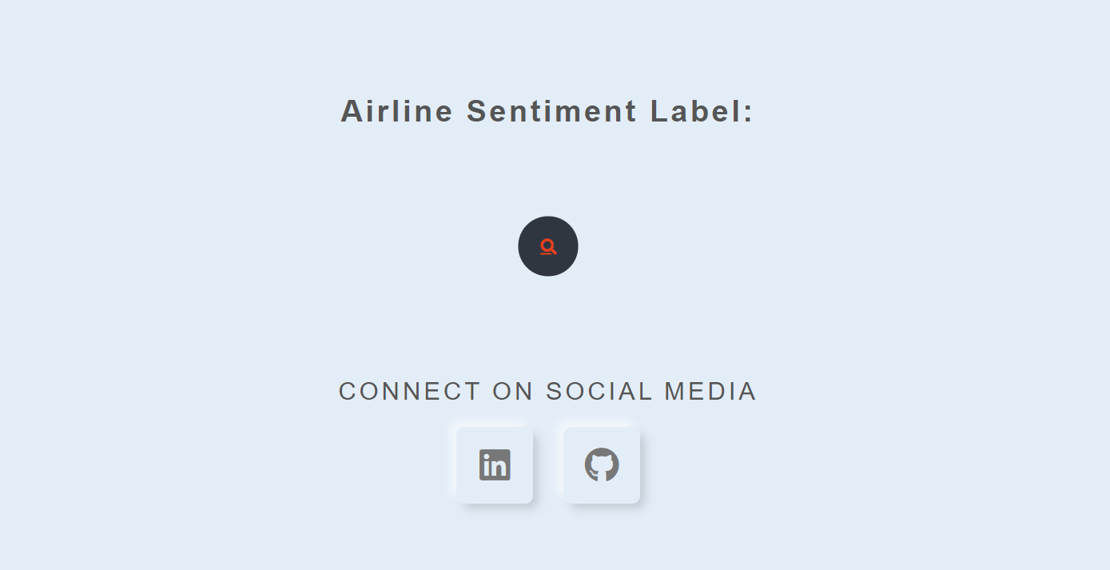
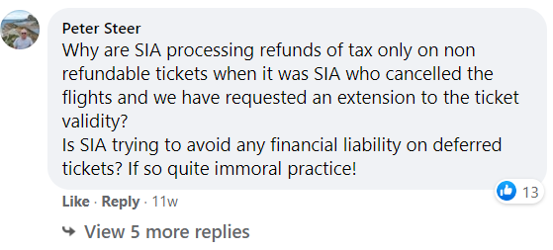
Prototype
click here
Notes:
Why are SIA processing refunds of tax only on non refundable tickets when it was SIA who cancelled the flights and we have requested an extension to the ticket validity?
Is SIA trying to avoid any financial liability on deferred tickets? If so quite immoral practice!

Slide 18
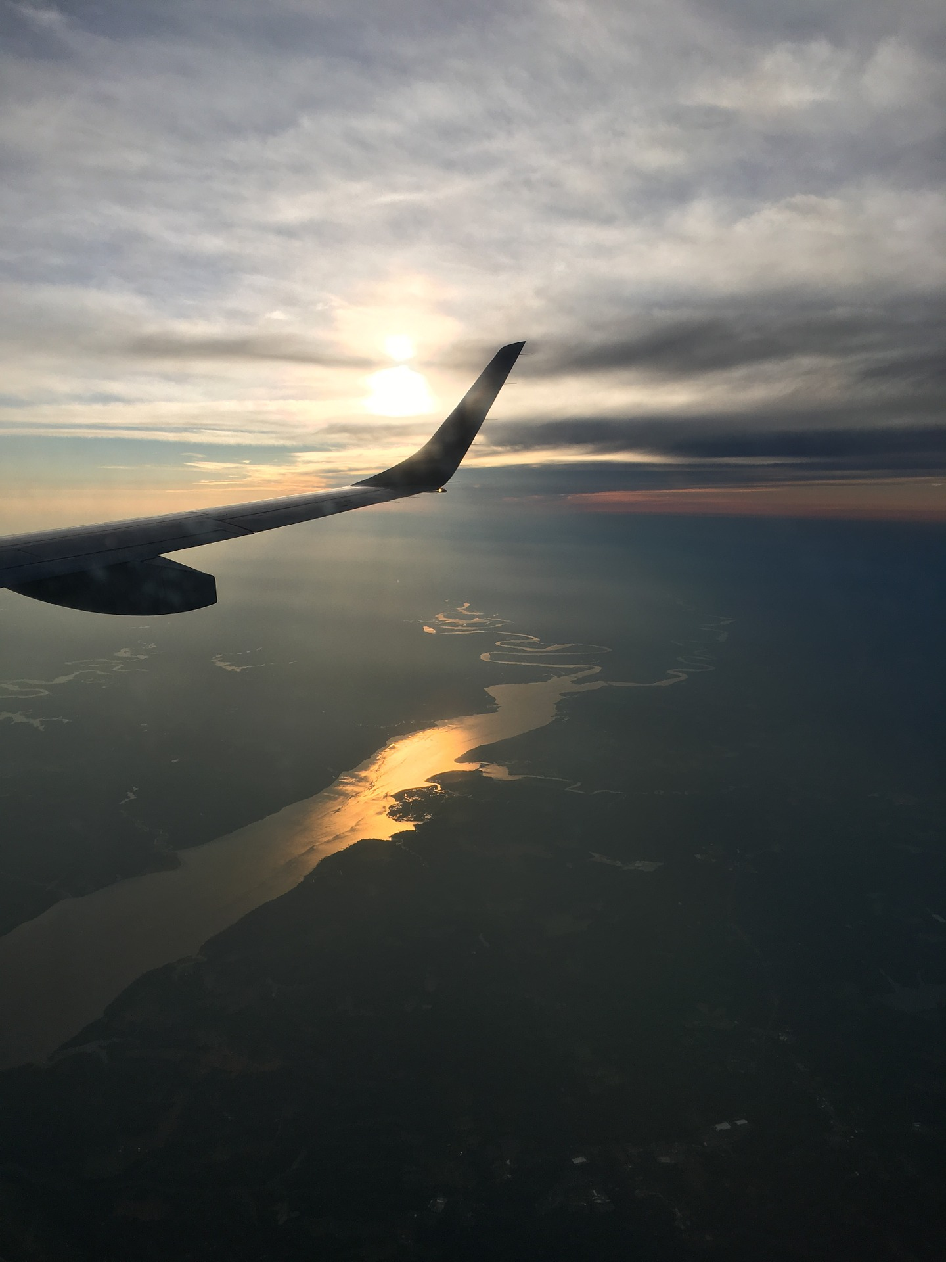
Conclusion
Notes:
To change the image on this slide, select the picture and delete it. Then click the Pictures icon in the placeholder to insert your own image.

Slide 19
Considerations
Limitation:
Current model is quite general. (working on 1 source)
Model cannot predict more than 1 topics
Future developments:
More in-depth segregation of topics to enhance efficiency.
Cabin crew
In-Flight Experience
Entertainment
Meals

Slide 20
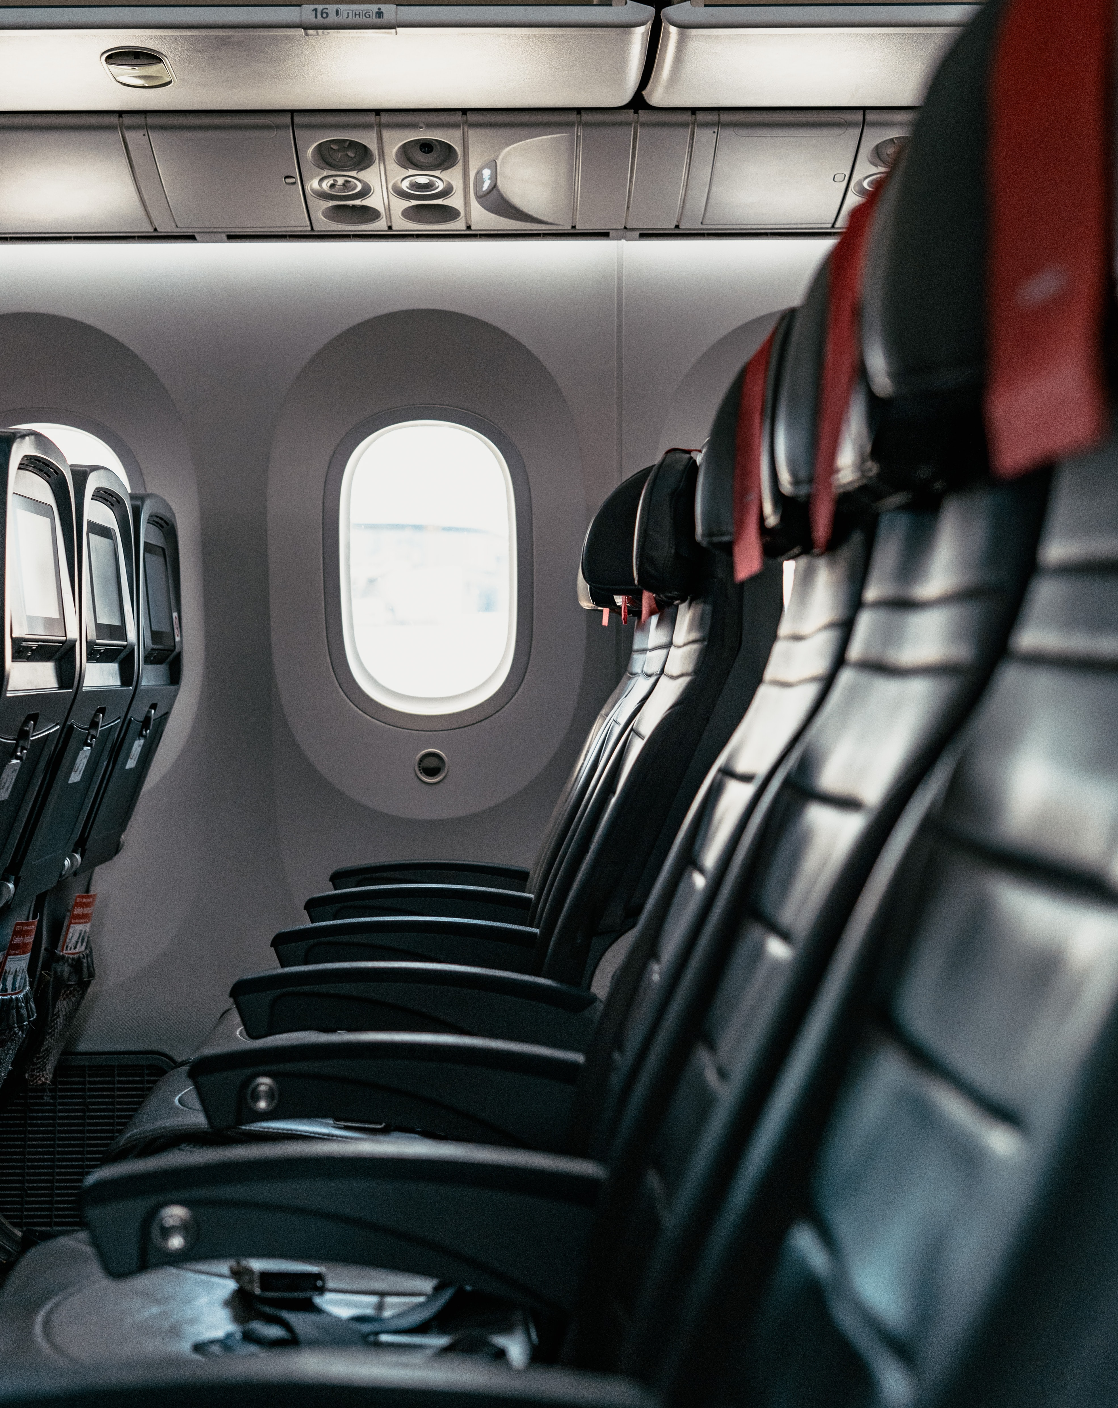
End of Presentation
Any questions?
- Gabriel -

